Slide 1




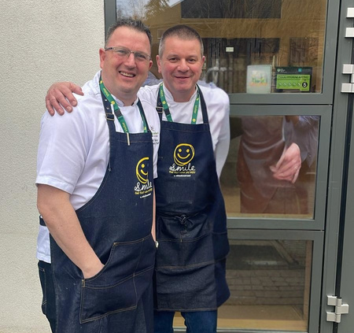


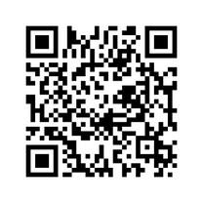

Welcome to
Edwards and Ward
Your new food caterer
Our Food Development Team
Our Food Development Team, David, & Nick, play an important role in E&W which consist of:
  Developing recipes and menus
  Training staff
  Supporting staff
  Hospitality
Most importantly, ensuring you are eating healthy food that you enjoy!
Register Here
for
Special Diets
Special Diets
Our Nutritionist Clare, works closely with the food development team ensuring all the recipes created are nourishing and according to regulation.
If you happen to have a special dietary requirement please scan the QR Code to register...
Food that makes you happy!

Slide 2








We want you to join us on this journey
Get involved in our Garden club
Join our fight against food waste
Why don’t you become a Taste Buddy?
Our taste buddies help with serving, setting, encouraging children to eat their food and also try new foods.
They are food ambassadors!
edwardsandward.co.uk

Slide 3

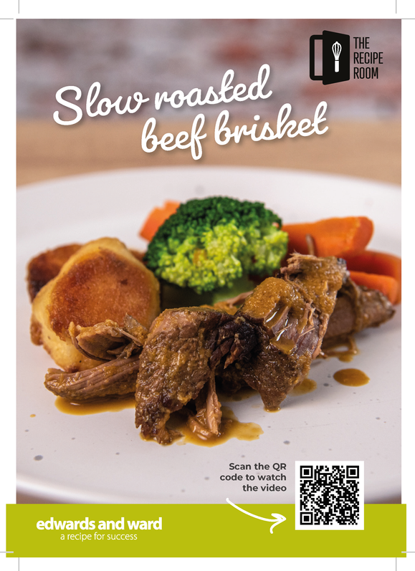

You will be seeing us soon
and continue to see us....
We will see you at parents evening and at
drops-off / pick-ups
Keep Smiling
See how our recipes are prepared
For our paid for guests, you could win a lunch for free
Food that makes you happy!

